Slide 1




RIDERS + SUBSCRIBERS analyzing rider habits to inform future ad spend
Seda Aydinoglu, Atri Bathani, Jo Borras, Javier Palma, and Sal Trevino
JUN2021

Slide 2
PROJECT OUTLINE
Project Summary
Hypothesis
Gathering the Data
Google Trends
City of Chicago
Baseball Almanac
NOAA Weather Data
Gas Prices
Oil Futures
Cleaning the Data
Installing and Using New Libraries
Merging the Data
Visualizing the Data
Finding Correlations and Patterns
Presenting Our Findings
Libraries Summary
Data Sources

Slide 3
PROJECT SUMMARY
We imagined ourselves working as analysts for Chicago bike-rental firm, Divvy, we will be analyzing trip and use data from both “as-needed” customer riders and regular subscribers and comparing that data to local weather and gas prices, as well as major sporting events, to see what trends emerge.
The end goal is to establish whether or not there is a correlation between seasonality, fuel, and local sporting events to Divvy rider, in order to create a better model for targeting ad dollars and convincing more people to ride Divvy.

Slide 4
HYPOTHESIS
We began the project trying to find correlations between the number of Divvy rides, local weather, major sporting events, and gas prices. We believed we would be able to show significant correlation and use that to advise the company’s ad spend based on oil futures, game schedules, and meteorological almanac data.
Our findings showed that there was a correlation with Divvy use and average daily temp., as well as fuel prices. At first, there did not seem to be a strong correlation between Divvy bike rentals and oil futures prices, however, which indicated that “current conditions” are a stronger driver for Divvy use.

Slide 5
DATA ACQUISITION
We used publicly-available Divvy rental data from 2019 pulled from the City of Chicago Data Portal, weather data from the NOAA, fuel prices came from the EIA, oil futures data came from Investing.com, broader Divvy search trends from Google Trends as the basis for our data gathering, using Zipfile to import and extract from large data sets.
We also pulled Chicago Cubs and White Sox game data from the Official Baseball Almanac site using Beautiful Soup, a Python package that extracts data from HTML tables on websites and converts them to dataframes that are useful in Python.

Slide 6
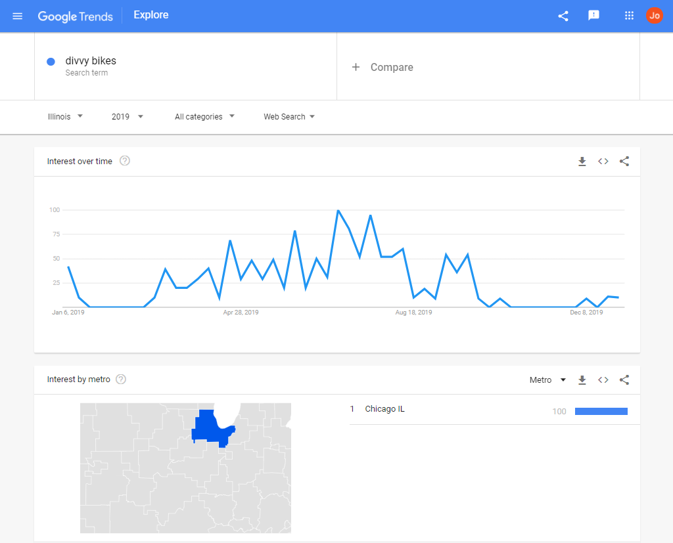
GOOGLE TRENDS
Search interest over the course of 2019 peaks in the summer months, with some additional higher search interest in the late weeks of December and into early January, coinciding with the holidays. A quick scan also shows search interest seems to be flat in the months of February and November.
We downloaded this search data as a .csv file, and then read the .csv into a dataframe using Pandas for manipulation and further visualization.

Slide 7
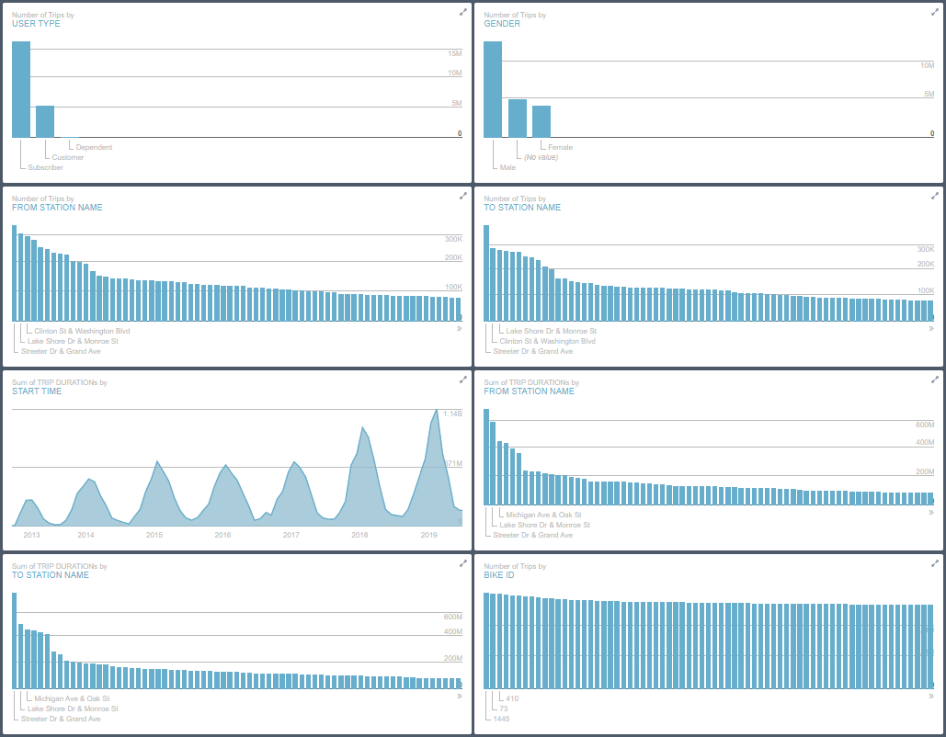
DIVVY CHICAGO DATA
The City of Chicago Data Portal provided highly detailed, usable data for our Divvy project that included demographic information about riders’ age and gender, start and end locations, average rental time (defined using “Start Time” and “End Time”, and– critically– whether or not the “User Type” is a “Subscriber” or “Customer”.
We were able to call the data as an API, then trim away the information we deemed unnecessary by dropping columns and combining certain other variables.

Slide 8
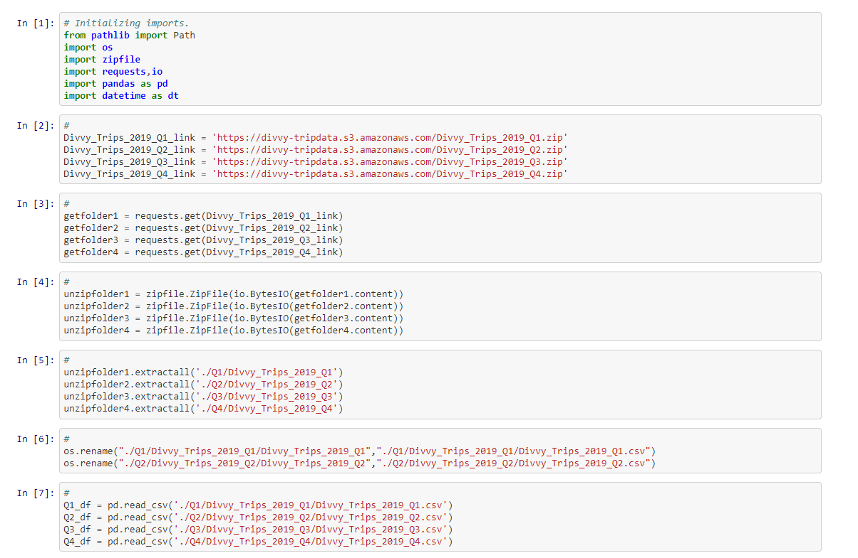
READING ZIPPED DATA
You can see some of the process that went into reading in the Divvy Trips Data in the code, at right, which shows the earliest part of the imports but is significant because of the zipfile library, which allowed us to pull in compressed data and extract the information we needed quickly.
This is one of the “new” libraries we used throughout the project that were not covered in class– this satisfies one of the requirements of this presentation.

Slide 9
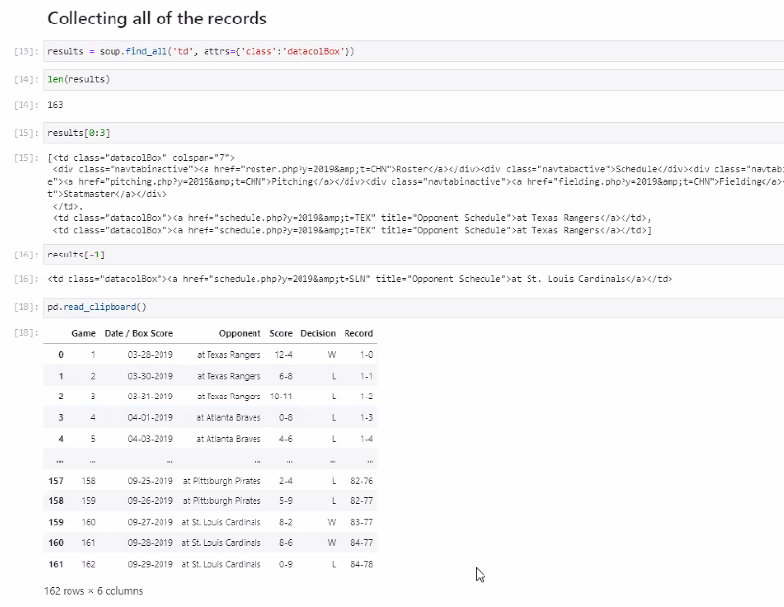
BASEBALL ALMANAC DATA
We pulled the 2019 Cubs and Sox game schedules, as well as location data and scores, using the pd.read_clipboard function in Pandas.
We used the regular expression “.str.contains(‘vs’, regex = False)” to determine which games were home games (relevant) vs. away games (irrelevant).

Slide 10
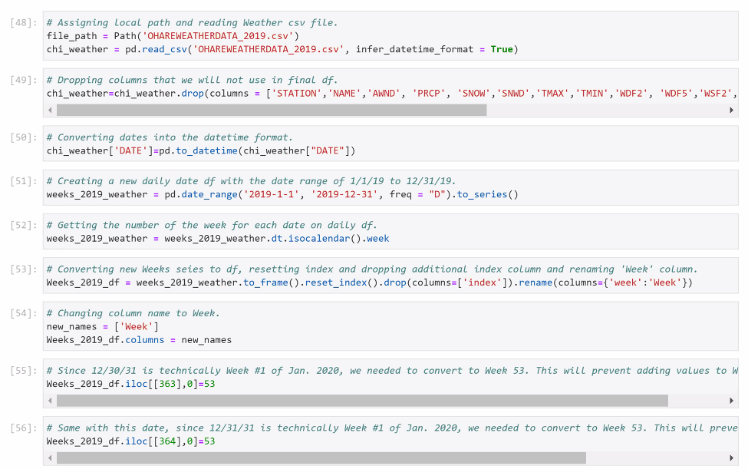
READING WEATHER DATA
We imported the weather data from the Chicago O’Hare weather stations using data compiled by the NOAA (National Oceanic and Atmospheric Association) using the pd.read_csv technique used in the exercises.
There was a significant amount of data, including high and low temperatures (tmax, tmin), precipitation types and amount, as well as weather “type” summary. We used the tavg (average daily temperature), and calculated the weekly mean temp using that data.

Slide 11
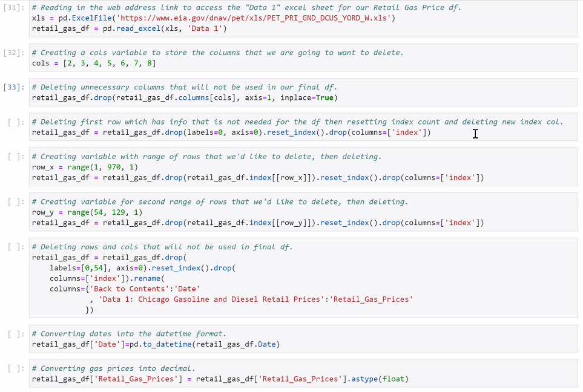
READING GAS PRICES
We read in the weekly gas prices from EIA (Energy Information Administration) data using the pd.read_excel function in Pandas, as well as the xlrd library, then deleted the unnecessary columns.
The most reliable (gov’t) gas price information was only available as a weekly average, this dictated our data formatting throughout the project and is the reason we organized all the other data by week.
xlrd is one of the “new” libraries we used throughout the project that were not covered in class– this satisfies one of the requirements of this presentation.

Slide 12
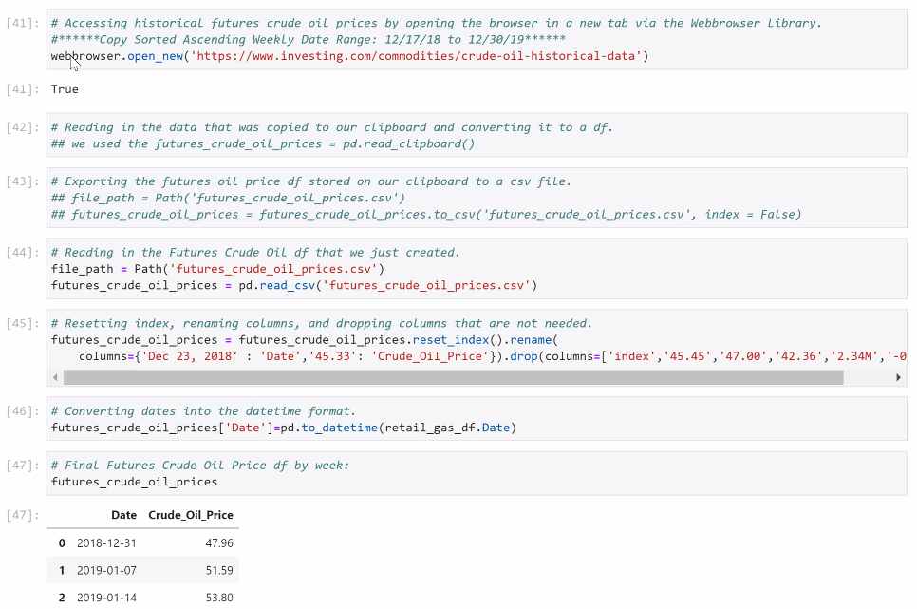
OIL FUTURES DATA
We imported the oil futures prices using the webbrowser library to get the data directly from the online source. The data was presented as a .csv, which we then converted to a dataframe using the pd.read_csv function in Pandas.
This is another one of the “new” libraries we used throughout the project that were not covered in class– this satisfies one of the requirements of this presentation.

Slide 13
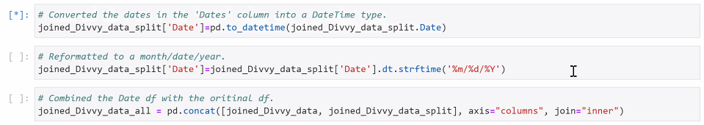
CLEANING THE DATA
As before, we needed to organize all the data into “Weeks” so it could be plotted against the weekly average gas prices. Since there are not baseball games every week, we filled in the missing weeks with “0” games.
Next, we split the Divvy data from “Date” into month and day, then grouped each day by its respective week before concating that data with the fuels df.

Slide 14
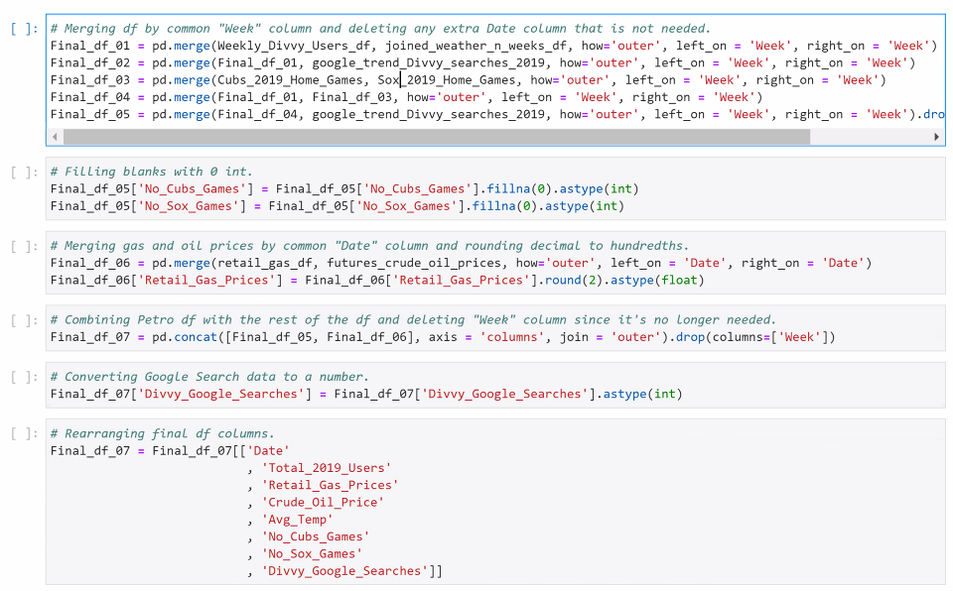
MERGING THE DATA
Once we applied similar logic to all the available data, we merged all the dataframes into a one single df that we then used to generate our plots and look for correlation.

Slide 15
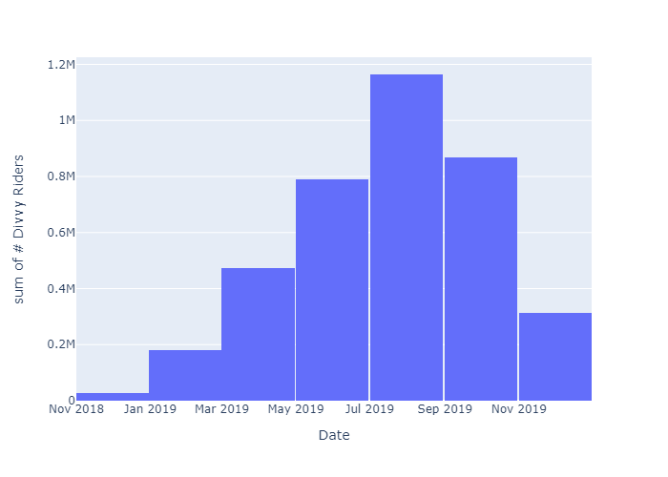
VISUALIZING DATA (1)
The first plot we did showed the sum total of Divvy riders throughout the course of the year. This followed our assumption that there would be more Divvy use in the warmer summer months than the colder winter months.

Slide 16
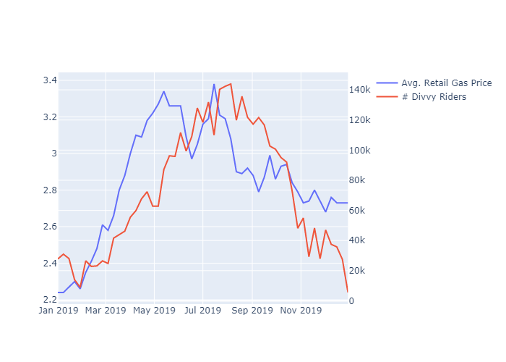
VISUALIZING DATA (2)
The first comparative plot we did showed the Avg. Retail Gas Price plotted against the number of Divvy Riders. There was a strong correlation here (0.7) as well as a similarly strong correlation between Gas Price and Google Search traffic related to Divvy bikes (0.68).
We observed that Divvy ridership, while correlated, lagged Average Gas Price by about four (4) weeks, implying that one or two expensive “fill-ups” would be enough to convince someone to try a Divvy on their commute.

Slide 17
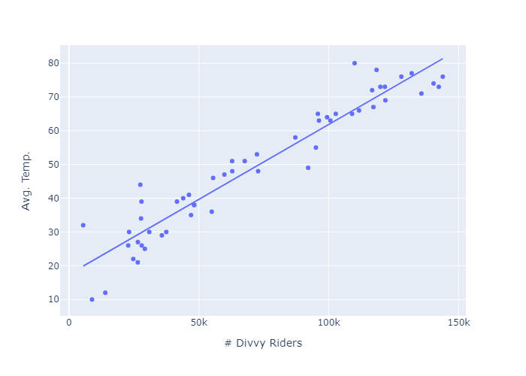
VISUALIZING DATA (3)
Looking at scatter plot for temperature and Divvy use, you can see that very strong correlation play out.

Slide 18
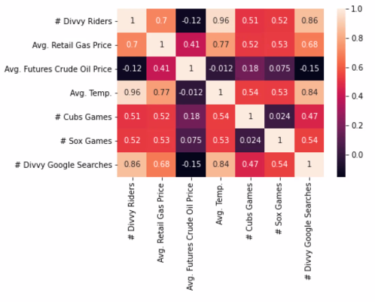
FINDING CORRELATIONS
Interestingly, the number of home baseball games (used as “major sporting events”) did not have a major impact on Divvy ridership (0.51 and 0.52 for Cobs and Sox, respectively).
We took this to indicate that people attended major sporting events using transportation that was already familiar to them. People who took public transport regularly would use public transport to a game, people who used Divvy would used Divvy, etc. This could present an opportunity to increase Divvy use in the future, if it were presented as a better alternative to the riders’ “usual” transportation choice.

Slide 19
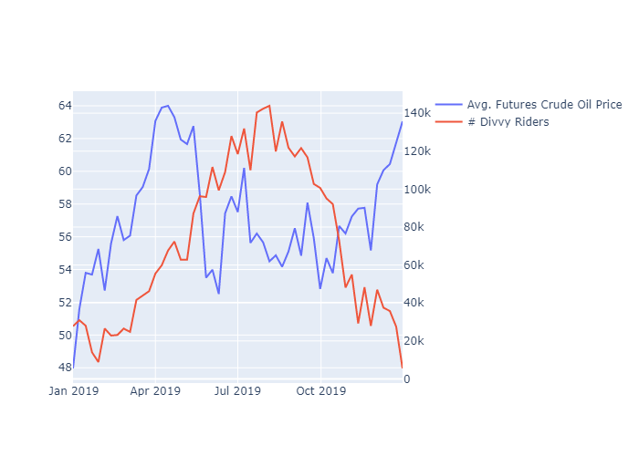
PRESENTING FINDINGS
Our original hypothesis was that fuel prices and Divvy rides would be strongly linked, and they were– but, initially, there wasn’t a clear correlation between oil futures (one indicator of future fuel prices).
Upon re-examination, we realized that the futures prices reflected prices 90-days out. Peak futures corresponded to peak Divvy use 90-days later, which means that we actually can use futures prices to predict demand.
We would recommend our ads and maintenance teams use spikes in oil futures pricing as a guide to plan out their bike deployment to commuter-heavy stations and increase web advertising in anticipation of search spikes.

Slide 20
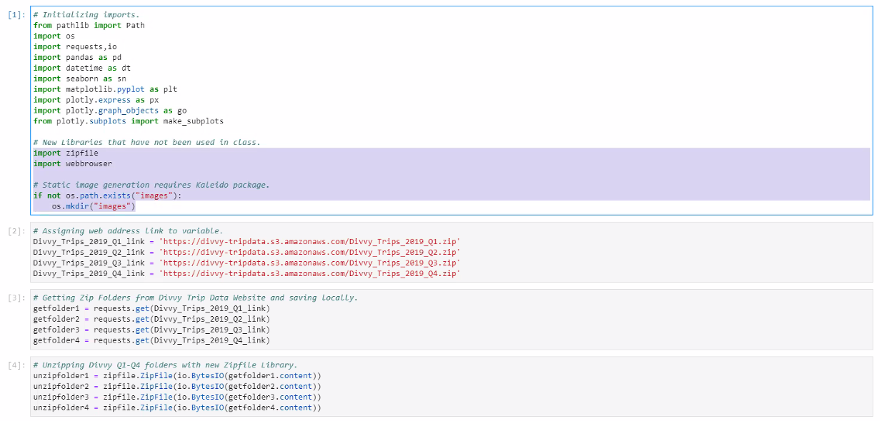
NEW LIBRARIES SUMMARY
By the end of the project, we had used a number of new libraries including zipfile, webbrowser, warnings, and xlrd to import and manage different data.

Slide 21
DATA SOURCES
.csv files are stored in our Group Project repo. Below are the links to the data described throughout the project.
Divvy Rental Data
https://data.cityofchicago.org/Transportation/Divvy-Trips/fg6s-gzvg
NOAA Weather Data
https://www.noaa.gov/
EIA Gas Prices
https://www.eia.gov/dnav/pet/hist/LeafHandler.ashx?n=PET&s=EMM_EPM0_PTE_NUS_DPG&f=W
Investing.com Oil Futures Prices
https://www.investing.com/commodities/crude-oil-streaming-chart
Baseball Games Data
https://www.baseball-almanac.com/teamstats/schedule.php?y=2019&t=CHN Cubs
https://www.baseball-almanac.com/teamstats/schedule.php?y=2019&t=CHA Sox

